Slide 1

Project Title –Steganography in action
[Student Name: Deviprasad N Shetty ]
AICTE Internship Student Registration ID) : STU639dd6ca8b4231671288522

Slide 2

PROBLEM STATEMENT
Develop a system that hides a secret message within an image (cover image) without visibly altering the image. The system should allow both encryption (embedding) and decryption (extraction) of the hidden message.

Slide 3
Project Description
Objective:
Develop an image steganography system that conceals a secret digital text message within an image.
Ensure that the modified image appears visually similar to the original image, thus avoiding suspicion.
Requirements:
Input: An image (carrier) and a secret message (digital text).
Output: An encrypted image containing the hidden message.
Process:
Encryption:
Convert the secret message into numeric form (e.g., byte array).
Modify the pixel values of the image using a steganography technique (e.g., Least Significant Bit (LSB) algorithm).
Save the modified image as the encrypted output.
Decryption:
Retrieve the encrypted image.
Use the same passcode (used during encryption) to reverse the process.
Reconstruct the original secret message from the modified image.

Slide 4

WHO ARE THE END USERS?
The end users of the image steganography system can vary based on the context and purpose of its implementation. Here are some potential end users:
Individuals with Privacy Concerns:
Everyday users who want to securely transmit sensitive information (such as personal messages, passwords, or confidential data) without arousing suspicion.
Journalists, activists, or whistleblowers who need to communicate securely in regions with restricted freedom of speech.
Law Enforcement and Intelligence Agencies:
Investigators who need to analyze images for hidden messages during criminal investigations.
Intelligence agencies monitoring communication channels for potential threats.
Security Professionals and Ethical Hackers:
Penetration testers and security experts who assess vulnerabilities in systems.
Professionals evaluating the robustness of steganography techniques.
Artists and Creatives:
Digital artists who want to embed secret messages or Easter eggs within their artwork.
Creators who use steganography for storytelling or puzzle-solving experiences.

Slide 5
WHO ARE THE END USERS?
Academic Researchers and Students:
Researchers studying steganography algorithms, security, and data hiding techniques.
Students exploring novel approaches to image manipulation and encryption.
Businesses and Corporations:
Companies that need secure communication channels for internal or external purposes.
Organizations protecting intellectual property or trade secrets.
Defense and Military Organizations:
Military personnel using steganography for covert communication during operations.
Defense agencies ensuring secure transmission of classified information.

Slide 6

Technology Used
OpenCV (cv2):
Purpose: OpenCV is a popular open-source computer vision library that provides tools for image processing, computer vision, and machine learning.
Usage in Code: The code uses OpenCV to read an image from a file (cv2.imread("flower.jpg")) and modify pixel values to encrypt a secret message.
Functionality: OpenCV allows image manipulation, pixel-level operations, and various image transformations.
File I/O:
Purpose: File input/output operations are essential for reading and writing data to files.
Usage in Code: The code reads an image from a file (“flower.jpg”) and writes the modified image to a new file (“encryptedMsg.jpg”).
Functionality: File I/O is crucial for handling data persistence and communication with external files.
Dictionary Data Structure:
Purpose: Dictionaries allow mapping between keys and values.
Usage in Code: The dictionaries d and c are used to map characters to their corresponding integer values and vice versa.
Functionality: Dictionaries provide efficient look-up and storage of key-value pairs.
Image Pixel Manipulation:
Purpose: The code modifies pixel values in the image to encode the secret message.
Usage in Code: The img[n, m, z] assignment changes the pixel value at position (n, m) in the image.
Functionality: Image pixel manipulation is essential for steganography and other image-based techniques.

Slide 7
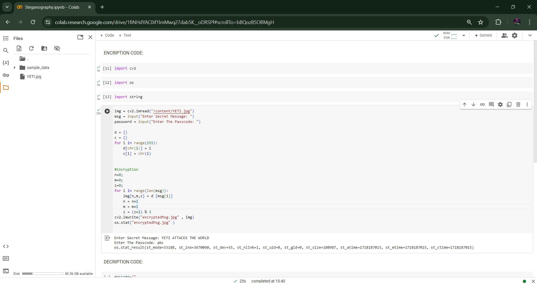
RESULTS
ENCRIPTION CODE:
Demo Link

Slide 8
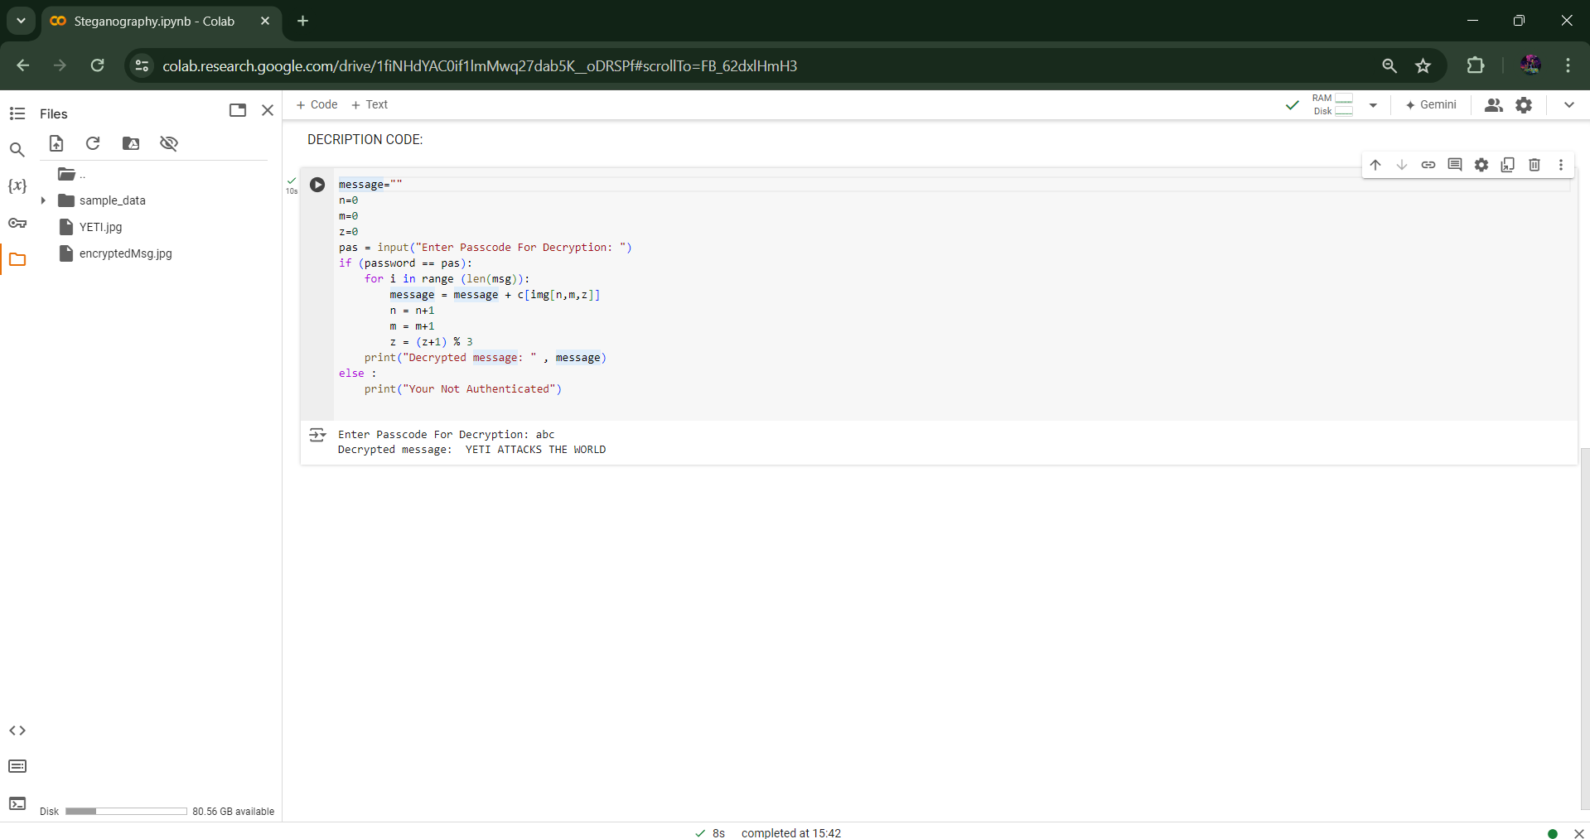
RESULTS
DECRIPTION CODE:
Demo Link

Slide 9
Thank you
Drive Link: https://drive.google.com/drive/folders/1f8HG9MeEA-UaGSe-Uxs-p8uAFVykT1lk?usp=drive_link
Github link: https://github.com/Deviprasad333/Deviprasad_N_Shetty-AICTE-Internship-Student-Registration-ID-STU639dd6ca8b4231671288522-
.
.

